Slide 1
Federal Budgets: The Tools of Fiscal Policy
15
Notes:
Pre-class music: “The Credit Song” by The Arrogant Worms (See Tip #523)
This is one of the most descriptive songs about economics–it covers a number of different economic topics, but one line that stands out is “If you cannot make your loan, well, do like the government and take out a bigger loan.” The lyrics of this song can be a good starting place when helping students begin to put real-world budget struggles in the proper context.

Slide 2
Previously
During the Great Recession
  lower output
  high unemployment
However, the Great Depression in the 1930s was much worse and lasted much longer.
Classical economists:
  market is self-correcting
  focus on long-run growth (expanding the LRAS)
Keynesian economists:
  market corrections can take time due to sticky wages
  focus on policy aimed at AD

Slide 3
Big Questions
How does the government spend?
How does the government tax?
What are budget deficits?

Slide 4
Government Budgets—1
2001–2005
  Budget deficit averaged $300 billion per year
2006–2008
  Budget deficit averaged $700 billion per year
2009
  Budget deficit was $1.4 trillion
Questions:
  Is this dangerous? Is debt killing the economy?
  What are the contributing causal factors?
  Who will pay this debt in the future?
Notes:
Lecture notes:
It is obvious that the government budget deficit numbers are quite large.
In recent years, government debt has increased dramatically.
Logic would say money borrowed has to eventually be paid back.
Ask your students: Do they anticipate being be part of the generation that pays it back?
If future generations are saddled with debt, will it prevent the economy from growing?
These are genuine concerns of many people and economists.

Slide 5

Government Budgets—2
A budget describes plans for spending and income.
Government budget:
  plan for spending and raising funds for the government
    Income or revenue: sources of funds
    Spending or “outlays”: uses of funds
Notes:
Lecture notes:
Students are probably familiar with creating a personal budget, laying out a plan for incoming and outgoing funds.
Similarly, a government budget is a plan for both spending and raising funds for the government.
There are two sides to a budget:
the sources of funds (income or revenue)
the uses of funds (spending or outlays)
The image on the slide: Fighter jets. Defense spending is an example of government spending (outlays).

Slide 6
Outlays and Revenue—1
The U.S. government spends $3 trillion each year ($10,000 for every citizen!)
Transfer payments:
  Payments made to individuals when no good or service is received in return
    Income assistance (welfare)
    Social security
Government outlays = Government spending + Transfer payments
Notes:
Lecture notes:
U.S. government spending includes purchases of goods and services. For example:
Roads
Bridges
Military equipment
Government employees
Transfer payments constitute a large (and growing) share of government outlays.
Recall: transfer payments are not included in GDP since no good or service is provided in exchange for the payments.
Transfer payments just represent a wealth transfer, not new production.
Total government outlays are the sum of government spending and transfer payments.

Slide 7
Outlays and Revenue—2
Government spending vs. transfer payments
  Spending: government buys goods or services
  Transfer: money is moved from one group to another
Government revenues
  Generally raised through taxes
  Other small fees as well (national park admittance)
Notes:
Lecture notes:
Government spending and transfer payments are different economic variables.
However, both represent the expenditures side of the government budget.
Government spending is when the government purchases something in the marketplace.
Transfer payments represent a redistribution of wealth from some individuals to others.
The majority of government income or revenue is generated through taxes.
Since the “other small fees” are pretty small, we generally just focus on tax revenues as the source of government revenues.

Slide 8
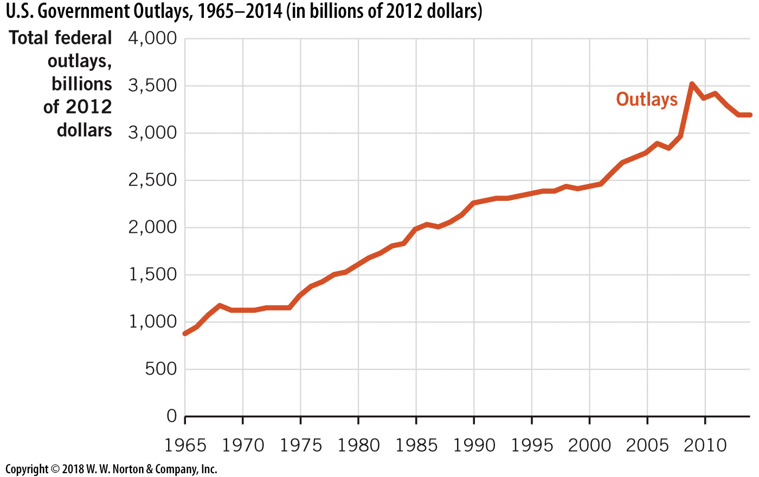
U.S. Government Outlays—1
Notes:
Image: Figure 15.1
Lecture notes:
Total outlays represent the spending side of the government budget.
The graph on the slide shows real outlays (in millions of 2012 dollars) since 1965.
Between 2001 and 2010, real outlays grew by 37 percent.
Total outlays are now over $3.5 trillion per year, or $10,000 per U.S. citizen.
Note: these are real inflation-adjusted trends.
We will explore the reasons for the continual increase in government expenditures in the remainder of this chapter.

Slide 9
Major Categories of National Government Spending
Mandatory outlays
  Determined by ongoing programs
    Social Security
    Medicare
  Cannot be altered during the budget process
  Altering requires long-run changes to existing laws
Discretionary outlays
  Can be altered when the annual budget is set
    Bridges
    Roads
    Payments to government workers
    Defense spending
Notes:
Lecture notes:
In order to change mandatory outlays, it literally takes an Act of Congress (law changes).
These terms are analogous to an individual’s expenditures:
Mandatory outlays:
Monthly rent
Monthly phone bill
Discretionary outlays:
Entertainment
Groceries (yes, people have to eat, but there is flexibility in spending choices depending on your current money situation)

Slide 10
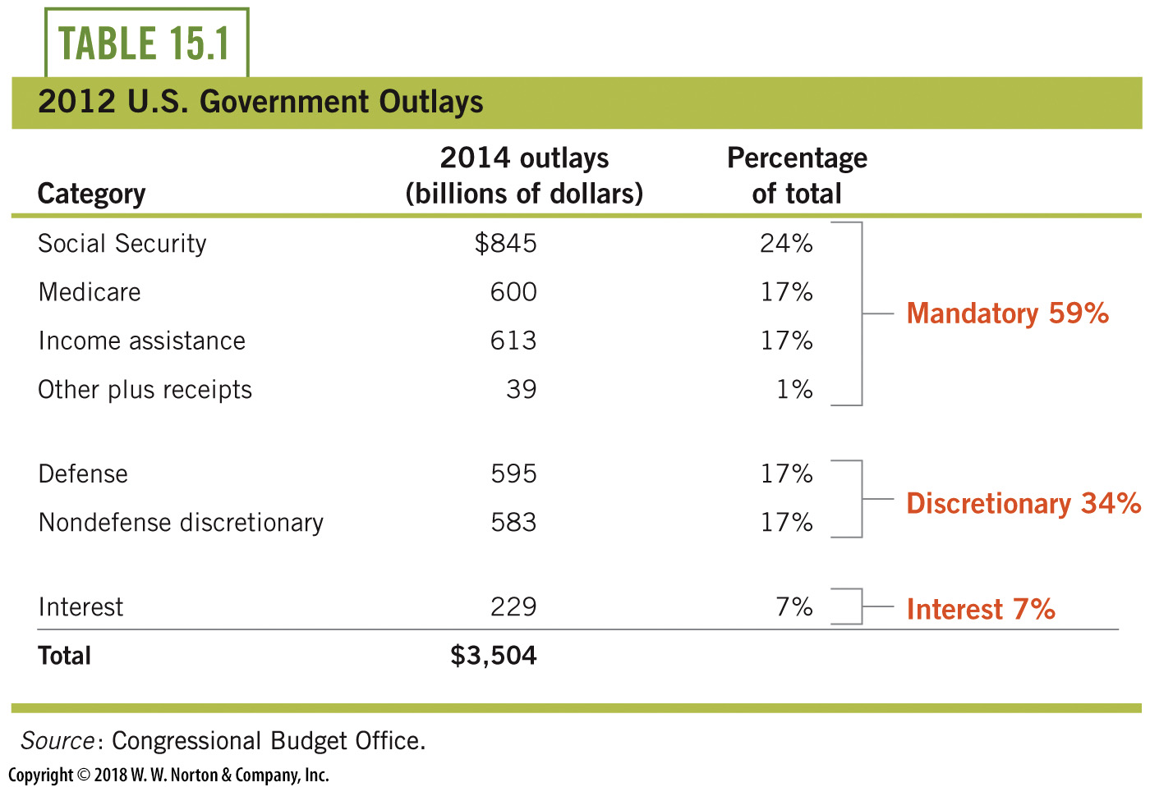
U.S. Government Outlays—2
Notes:
Lecture notes:
An interesting trend:
Social Security is a bigger expense than defense spending.
A lot of the rise in Social Security spending can be attributed to changing demographics.
As our country ages and baby boomers retire, more concerns on huge spending increases will arise here.
The same spending concerns are relevant with Medicare as our society ages.
Many people are also concerned about the interest paid on our debts.
Students may wonder why since it is the smallest category of U.S debt.
There is an opportunity cost associated with these interest payments.
How many schools and hospitals could have been funded with that money?
Note: Many budget debates involve people arguing over discretionary items.
However, if we include interest payments as obligatory, less than 35 percent of the U.S. budget is discretionary.
The remainder of government spending goes toward mandatory outlays.

Slide 11
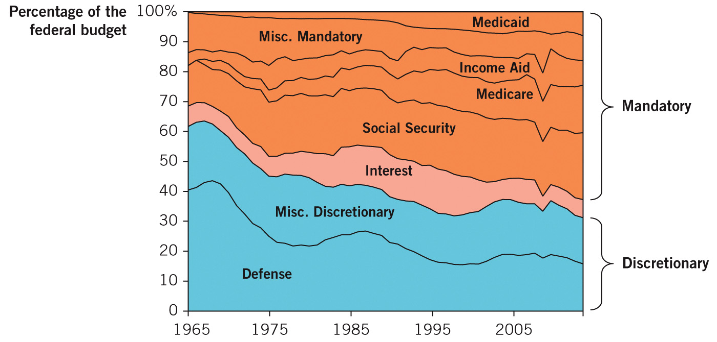
Historical Outlay Shares
Notes:
Image: Figure 15.2
Lecture notes:
The figure plots U.S. federal budget categories as portions of total outlays for the years 1965–2014.
The orange-shaded categories are the mandatory spending categories.
Fifty years ago, mandatory spending was about one-third of the U.S. federal budget.
Now, just Social Security and Medicare together account for more than 40 percent of the U.S. federal budget, up from only 13 percent in 1962.
The cause of this growth in mandatory spending is largely political, as more programs have been added (Medicare was added in 1966, and then expanded in 2006).
But also changes in demographics have contributed, as more and more U.S. citizens now qualify for old-age benefits.

Slide 12
Practice What You Know—1
Which of the following is part of mandatory outlays?
  Social Security
  defense spending
  government employee salaries
  infrastructure maintenance
Notes:
Clicker question:
Correct answer: A, Social Security
Changing spending on Social Security would literally require an act of Congress.

Slide 13
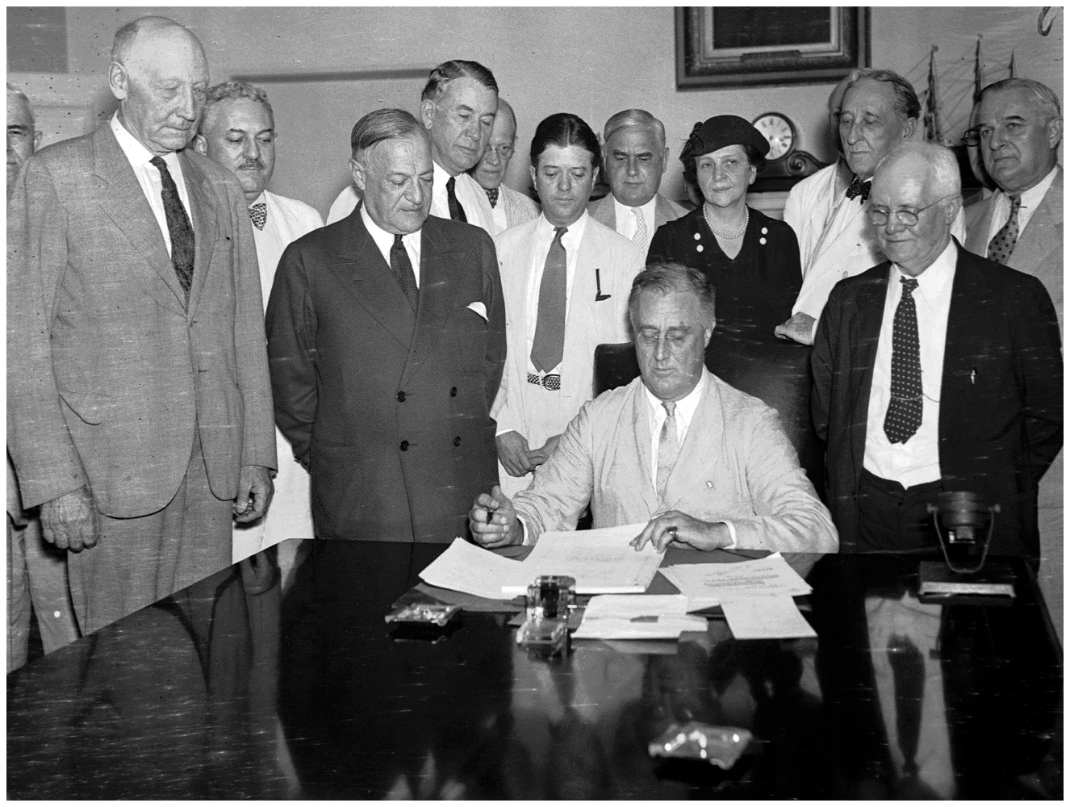
Social Security
Social Security
  Government-administered retirement program
  Enacted in 1935 by FDR as part of the New Deal
  Requires workers to contribute a portion of their earnings to the Social Security Trust Fund
Purpose:
  Guarantee that American
  workers retire with at least
  some retirement income
Notes:
Lecture notes:
Social security:
A government-administered retirement program signed into law by Franklin Roosevelt (FDR) in 1935.
Workers today contribute a portion of their earnings into the Social Security Trust Fund with the expectation that when they retire, they will receive this money back, including a modest growth rate.
Theoretically, the money you contribute today you will get back at retirement with a modest return on investment.
The goal of the program is to guarantee that no U.S. worker retires with no retirement income.
The image on the slide: FDR signs Social Security Act in 1935.
Additional Source:
Have students read the following for additional background information on the Social Security Program:
“Social Security: A Program and Policy History” by Patricia P. Martin and David A. Weaver. Social Security Bulletin, Vol. 66, No. 1, 2005.

Slide 14
Social Security Historically
Social Security 1930s
  Few retirees
  Lots of workers paying in
  Social Security tax: 2%
Workers paying in > Retirees receiving benefits
Positive balance
Social Security today
  Millions of baby boomers beginning to retire
  Fewer workers paying in
  Social Security tax: 15.3%
Retirees receiving benefits > Workers paying in
Negative balance
Notes:
Lecture notes:
At the beginning of the Social Security program, there were few retirees receiving funds.
However, there were many workers paying into the Social Security Trust Fund.
Workers paid into the program 2 percent of wages (half paid by workers, half by employer).
In the early stages of Social Security, there were more workers paying into the program than there were retirees receiving benefits.
The Trust Fund had a positive balance.
However, today, millions of baby boomers are beginning to retire and people are living longer.
There are also fewer workers paying into the Trust Fund.
Consequently, the Trust Fund balance is declining and the Social Security tax as a proportion of wages has increased to 15.3 percent of the worker’s pay on the first $110,100 a person earns.
Typically, the worker and the firm split this tax bill, each paying 7.65 percent.
This illustrates the concerns people have of an “unsustainable” Social Security program.
It can’t survive indefinitely if there are more funds going out than coming in.
Additional Source:
“The Future Financial Status of the Social Security Program” by Stephen C. Goss Social Security Bulletin, Vol. 70, No. 3, 2010.

Slide 15
Medicare
Medicare
  Federal program that funds health care for retirees
  Established in 1965 by Lyndon Johnson
  Law requires current workers to pay Medicare taxes (with promise of insurance upon retirement)
Goal
  Ensure that all retired workers have some funding for their health care
Notes:
Lecture notes:
Given their setup, both Social Security and Medicare naturally generated substantial tax revenue with very few outlays, since the paying workers don’t retire immediately.

Slide 16
Social Security and Medicare
Addition and expansion of programs
Demographic changes
  People are living longer today.
  Baby boomers are now entering retirement and drawing benefits.
Notes:
Lecture notes:
Part of the growth in mandatory spending has been largely political, as more programs have been added (Medicare was added in 1966, and then expanded in 2006).
However, the majority of the reason that mandatory spending has increased is due to demographic changes.
More people than before draw postretirement benefits longer.
Those who paid into the programs for many years are now retired and drawing benefits.
Particularly, the baby boomer generation is entering retirement age.
Baby boomers were born in the years 1946–1964 and represent a discrete increase in the population. The oldest boomers reached 65 years old in 2011.
The implication is that, going forward, we’ll have fewer and fewer workers (revenue sources) for every Social Security beneficiary (outlay).

Slide 17
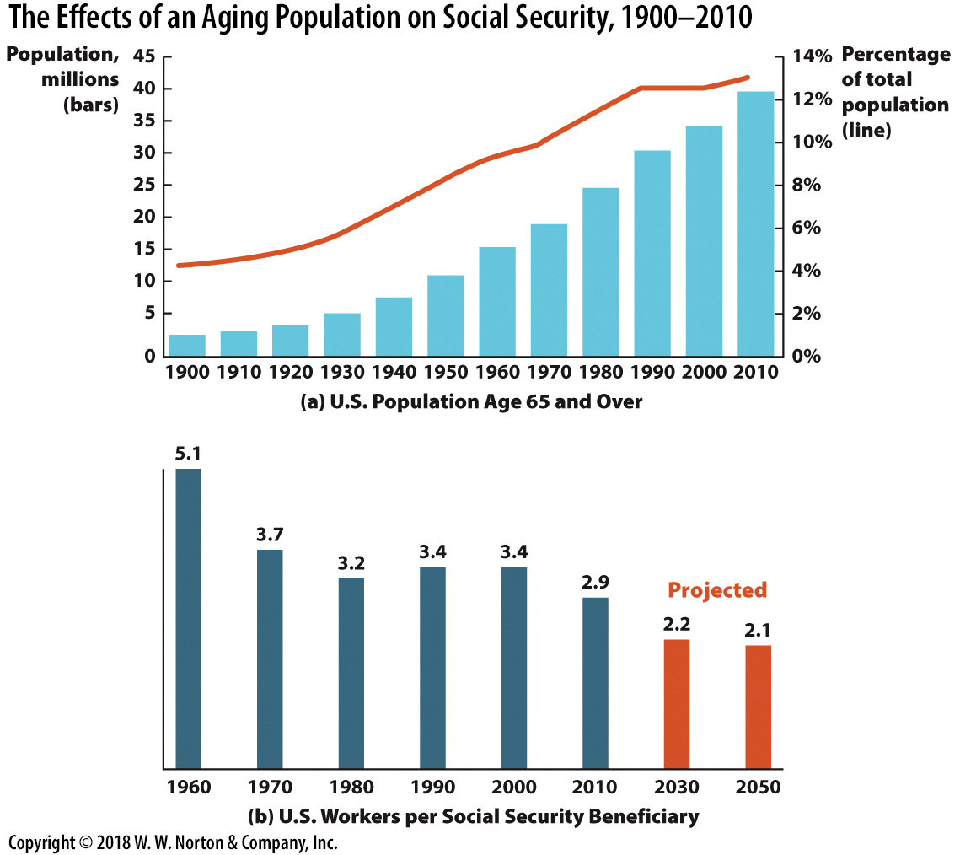
Aging Population, Fewer Workers, More Beneficiaries
Notes:
Image: Figure 15.3
Lecture notes:
Panel A:
Shows the U.S. population aged 65 and over by decade since 1900.
The graph shows both the number (the blue bars) and also indicates how big this group is as a portion of the total U.S. population (red line).
This portion will only grow as we go forward, with the baby boomers set to retire over the next two decades.
Panel B:
Plots the number of workers per Social Security beneficiary since 1960.
In 1960, there were more than five workers per beneficiary in the Social Security system.
As such, it wasn’t very difficult to accumulate a large Social Security Trust Fund.
But now, there are fewer than three workers per beneficiary, and as the baby boomers retire, this is set to fall to just above two (notice the projections for the future!).

Slide 18
The First S.S. Recipient
The first Social Security recipient: Ida May Fuller
  Received check 00-000-001 in January 1940
Taxes and outlays
  Ida May Fuller worked for three years under the program, and was taxed a total of $24.75.
  She lived to be 100 years old and collected a total of $22,888.92 from Social Security!
  If this were a typical experience, the program would not be sustainable.
Notes:
“Beyond the Book” Slide
Some people are still concerned about the sustainability of Social Security. Consider the following:
Our country’s age average is increasing.
More and more people are collecting Social Security while fewer and fewer are paying into it.
People are living longer.
All of these factors will put stress on the Social Security program.
Sources:
http://www.ssa.gov/history/imf.html
http://www.ssa.gov/history/briefhistory3.html#idamay

Slide 19
Practice What You Know—2
Social Security and Medicare outlays:
  are funded by income tax.
  have increased in size recently.
  are used to make sure working-age adults stay healthy.
  are part of discretionary spending.
Notes:
Clicker question
Correct answer: B, have increased in size recently.
The reason for the increase in the size of outlays is due to a change in demographics. Our society is aging, boomers are retiring, and people are living longer.
Why not (a)? Social Security and Medicare are forms of payroll taxes, but they are separate from regular “income tax.”

Slide 20
Current Fiscal Issues
Increased government spending began recently:
  Increased defense spending following Sept. 11, 2001
    2001: Defense spending was 16.5% of the federal budget
    2010: Defense spending was 19.1% of the federal budget
  Increased spending on Social Security and Medicare
  Government responses to the Great Recession (2008)
    2007: $2.87 trillion outlay
    2009: $3.58 trillion outlay
Notes:
Lecture notes
Recent increases in government spending have been caused by a variety of factors:
An increase in defense spending in the wake of the September 11, 2001, terrorist attacks.
An increase in spending on Social Security and Medicare (for reasons discussed previously).
The government fiscal policy responses to the Great Recession beginning in 2008.
Total real federal outlays increased 25 percent from 2007 to 2009.

Slide 21
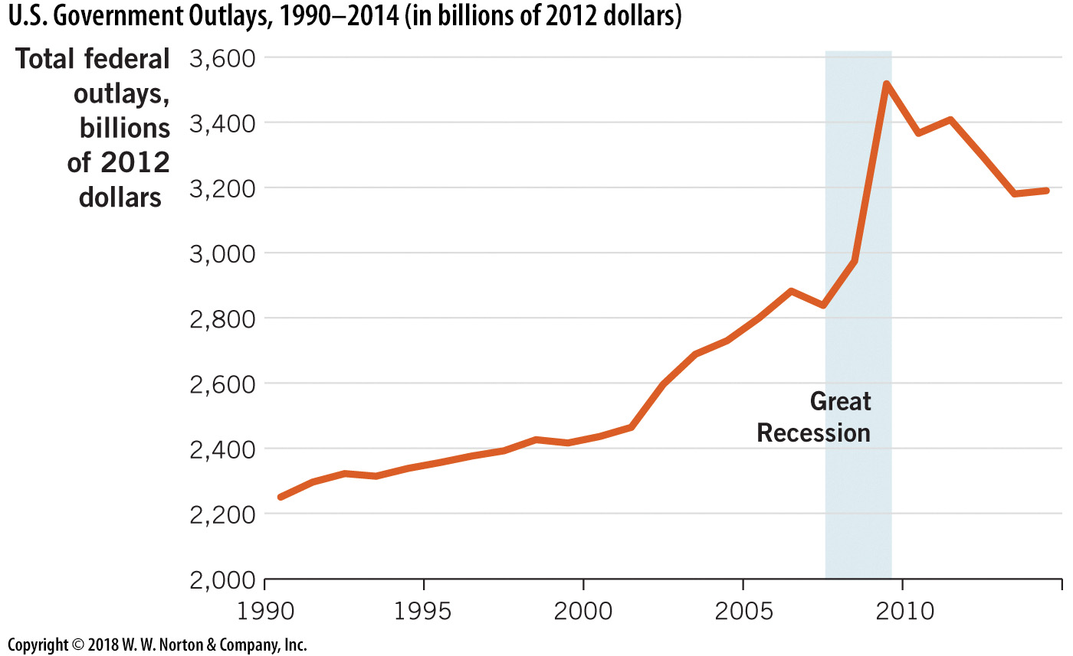
U.S. Government Outlays
1990–2014
Notes:
Image: Figure 15.4
Lecture notes:
The rate of growth of U.S. government outlays has increased significantly in recent years.
This graph shows a clear increase in spending after the World Trade Center attack on September 11, 2001.
Also notice the large spending increases during and after the Great Recession.

Slide 22
How do Federal Governments Raise Revenue?
Most government revenue comes from taxes
Payroll taxes (deducted from paychecks)
  Income, Social Security, and Medicare tax combined for 80% of all federal tax revenue in 2014
Other tax revenue sources
  Corporate, estate and gift, excise, and custom taxes
Notes:
Lecture notes:
Most people probably don’t enjoy paying taxes, but government activity must be paid for.
A significant majority of federal tax revenue comes from income, Social Security, and Medicare tax.
The remaining 20 percent of revenue is funded by corporate, estate and gift, excise, and custom taxes.

Slide 23
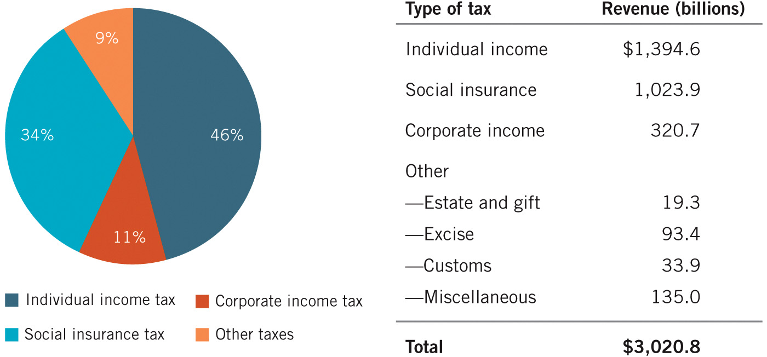
U.S. Federal Tax Revenue Sources, 2014
Notes:
Image: Figure 15.5
Lecture notes:
Total tax revenue in 2014 was about $3 trillion.
The major sources of tax revenue for the U.S. government are the two payroll taxes (deducted from workers’ paychecks): the individual income tax and the social insurance (Social Security and Medicare) tax.
In 2014, these two categories accounted for 80 percent of all tax revenue.
The other major sources of tax revenue, which include corporate taxes, estate and gift taxes, excise taxes (taxes on particular goods like gasoline), and customs taxes (this is revenue from tariffs levied on imports), together only contribute 19 percent of the U.S. federal tax revenue.

Slide 24
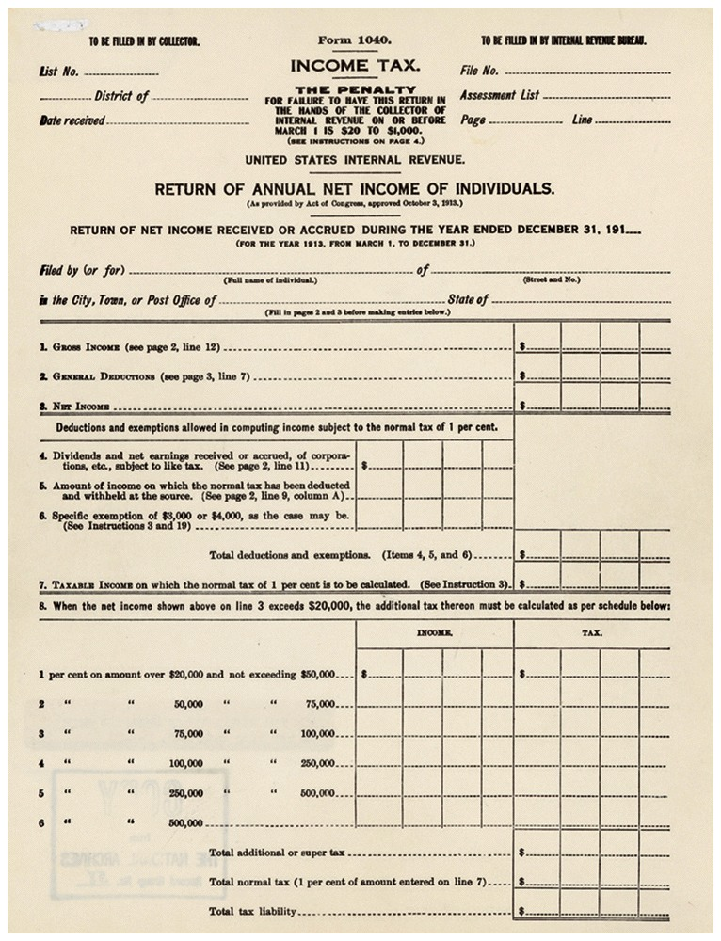
The Mechanics of Payroll Taxes
Progressive tax system
  Higher-income individuals
  pay a larger fraction of
  their incomes in taxes
In a progressive tax system:
  Marginal tax rate: the tax rate paid
  on the next dollar of income
    Marginal tax rates increase with
    higher earnings
  Average tax rate: total tax paid
  divided by taxable income
    Average tax rate < marginal tax rate
Notes:
Lecture notes:
Progressive taxation generally means that earnings are divided into “brackets.”
Lower brackets of your income are hit by lower marginal tax rates.
Higher brackets of your income are hit by higher marginal tax rates.
Regarding the image on the slide:
This is the original Form 1040, the form taxpayers submit to the IRS with their income taxes, in 1913.
Note that the form was one page long.
Toward the bottom of the form, the six tax brackets are detailed: from 1 percent to 6 percent.
This means the highest marginal tax rate in 1913 was just 6 percent, and this was on income greater than $500,000, which is more than $11 million in current dollars!

Slide 25
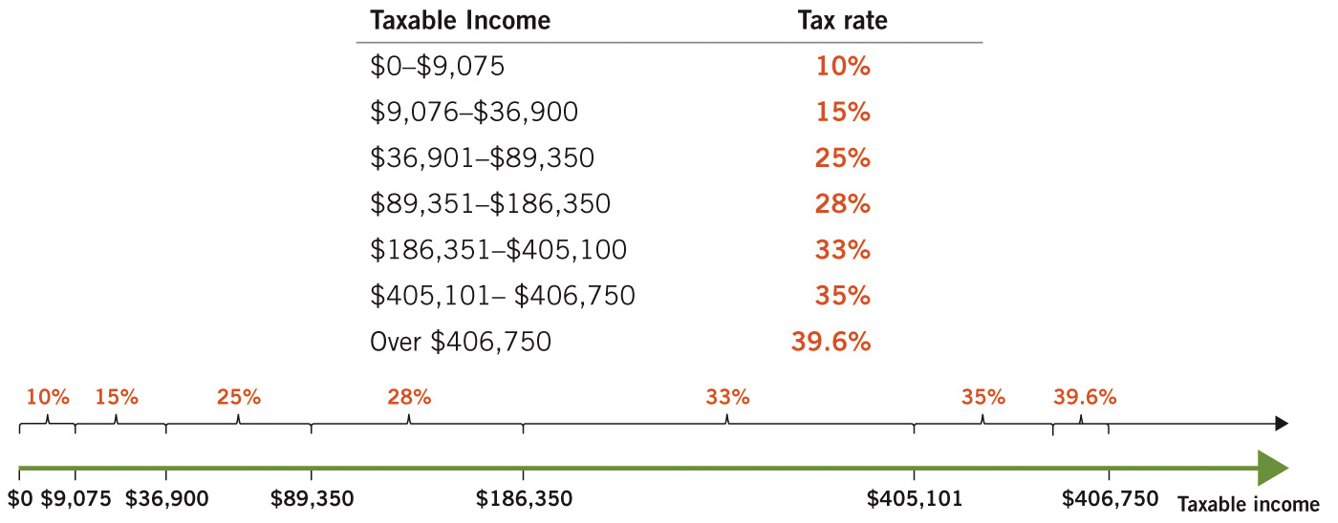
U.S. Federal Tax Rates, 2014
Notes:
Image: Figure 15.6
Lecture notes:
These tax rates are marginal tax rates, which means that they apply only to dollars within the specified income ranges.
For example, all income earned between $36,901 and $89,350 is taxed at 25 percent.
But, if someone earns $89,351, that last dollar is taxed at the 28 percent rate.

Slide 26
Historical Income Tax Rates
The U.S. income tax is only about 100 years old
  The highest marginal tax rate in 1913 was 6%
  Applied to earnings over $500,000 ($11 million today)
Marginal tax rates rose quickly
  The top marginal rate in 1918 was 77%
  Applied to income over $2 million
  Highest top marginal rates occurred in 1945 at 94%
Notes:
Lecture notes:
Prior to 1913, most taxes were generated by import tariffs.
In 1913, the passage of the 16th amendment allowed the government to collect an income tax.
The 6 percent marginal tax rate only applied to people like Henry Ford, Andrew Carnegie, and John Rockefeller.
By 1918, the top marginal rate rose to 77 percent.
This rate applied only to income over $2 million, but it meant that every dollar earned beyond $2 million yielded only 23 cents to the income earner.
The next slide plots the top marginal income tax rates in the United States from 1913 to 2015.
Additional Source:
http://www.loc.gov/rr/business/hottopic/irs_history.html

Slide 27
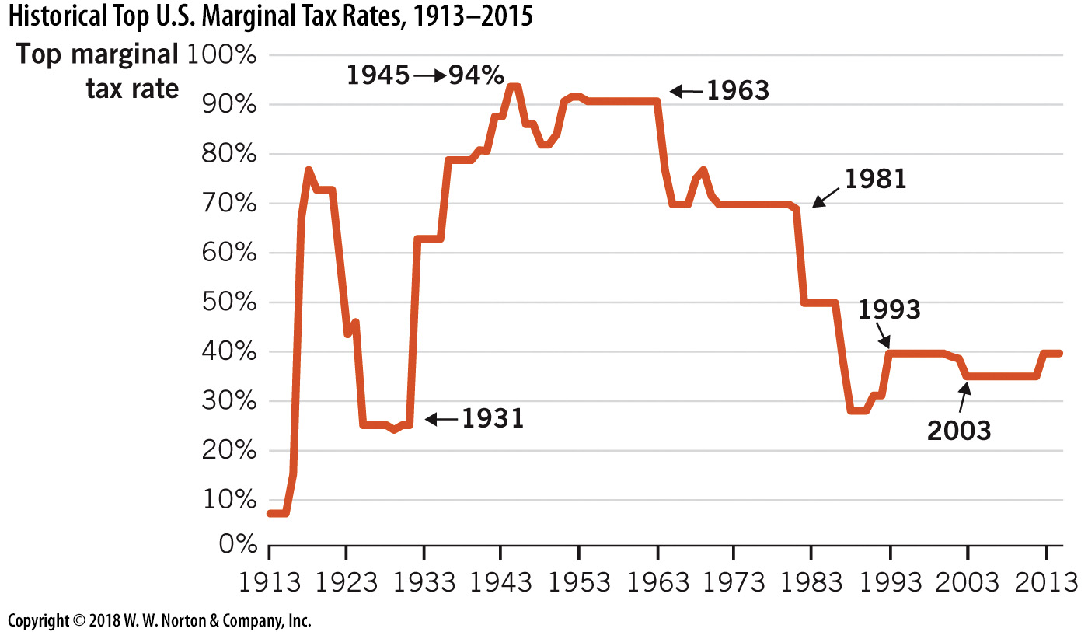
Historical Top U.S.
Marginal Tax Rates
Notes:
Image: Figure 15.7
Lecture notes:
Note that while this figure shows only the top rate, it is a good indicator of the general level of rates over time.
There are several key historical dates:
In 1931 (during the Great Depression), marginal tax rates were increased significantly to 80 percent by Presidents Hoover and Roosevelt, in attempts to balance the budget.
In 1963 and 1981, major downward revisions occurred.
In 1993, President Kennedy lowered the top rate from 90 percent to 70 percent.
In the 1980s, President Reagan lowered marginal tax rates further, and by the end of the decade, the top marginal rate was 28 percent.
In 1993, tax rates rose to 39 percent.
In 2003, rates fell to their recent levels (35 percent), as a result of urging by President George W. Bush.

Slide 28
Practice What You Know—3
Income taxes in the United States can be described as:
  progressive.
  regressive.
  flat.
  U-shaped.
Notes:
Clicker question:
Correct answer: A, progressive.
Progressive taxation means that higher incomes are charged higher tax rates.
Your first few dollars are taxed little (if at all), but marginal dollars that you earn at higher income levels are taxed at higher rates.

Slide 29
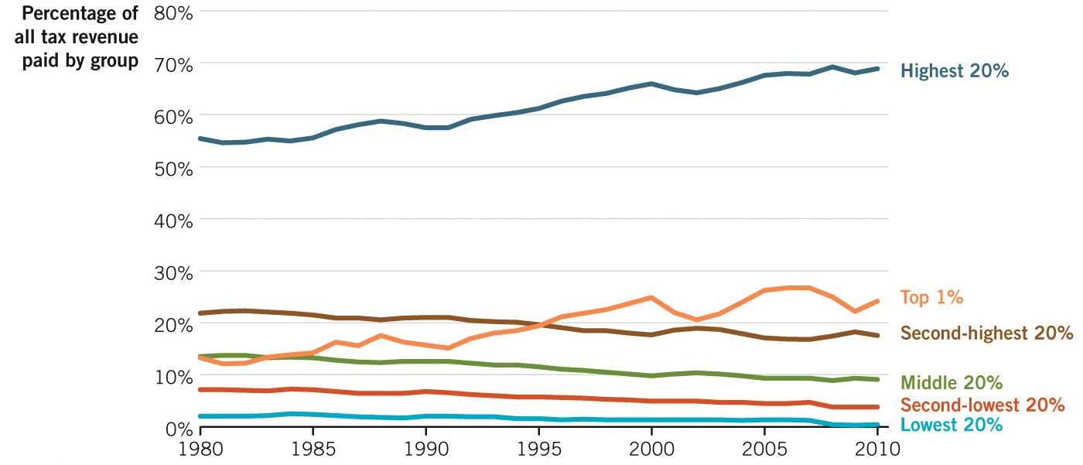
Who Pays for Government?
Notes:
Image: Figure 15.8
Lecture notes:
The share of tax liability by income group shows how much of the total taxes paid (includes both income and social insurance taxes) come from each income group.
The middle income group in the United States now pays less than 10 percent of all taxes paid.
The wealthiest 20 percent (the top line above) of income earners paid almost 70 percent of all federal taxes in 2010.
The top 1 percent of all income earners paid around 25 percent of all income taxes paid in 2010.
The poorest 40 percent paid just 4 percent of federal taxes in 2010.

Slide 30
Outlays and Revenue—3
Budget deficit
  Outlays > Revenues
  More funds flowing out than in
Budget surplus
  Revenues > Outlays
  More funds flowing in than out
2009: $1.4 trillion budget deficit, largest in U.S. history
Notes:
Lecture notes:
The concerns of many people stem from the fact that, in recent year, we have a budget deficit almost every year.
These deficits get added to the national debt.
The deficit-to-GDP ratio is a more informative gauge of the magnitude of deficits over time compared to just looking at the actual amount of dollar deficits.
The deficit-to-GDP ratio accounts for economic growth.
In 2009, the U.S. deficit was $1.4 trillion.
In level amounts, this is the largest deficit in U.S. history.
However, when examined as a portion of GDP, deficits during WWII were larger.

Slide 31
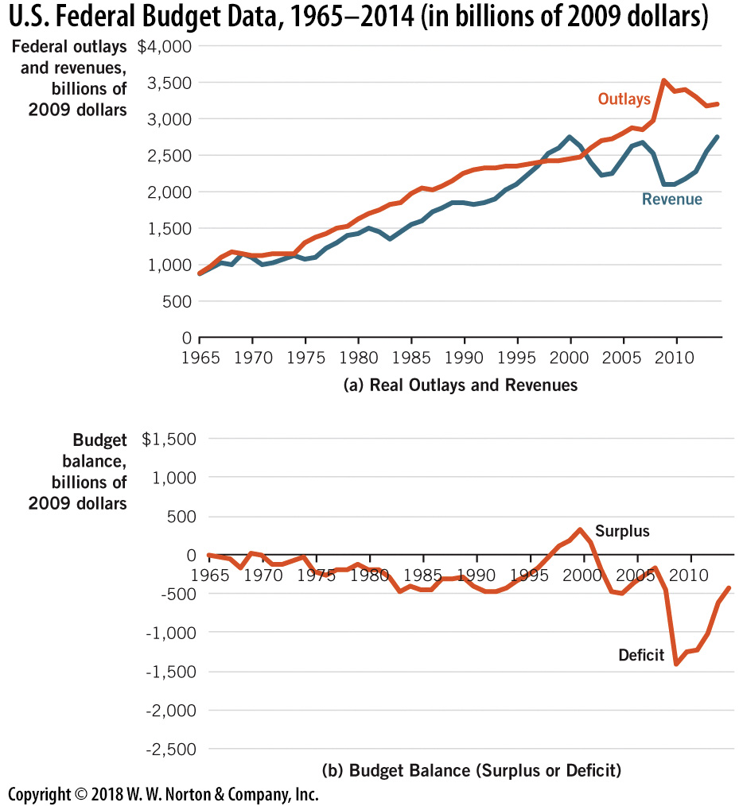
U.S. Federal Budget Data
1965–2014
Notes:
Image: Figure 15.9
Lecture notes:
Panel A:
Shows real outlays (orange) and revenue (blue) for the U.S. federal government budget since 1965.
When the outlays exceed revenue, this indicates a budget deficit for that year, that is, when the orange line is above the blue line.
Panel B:
Shows the real budget balance (negative values indicate a deficit).
The Great Recession (and government responses) helped to create the 2009 deficit of $1.4 trillion (in 2010 dollars), the largest in U.S. history.

Slide 32
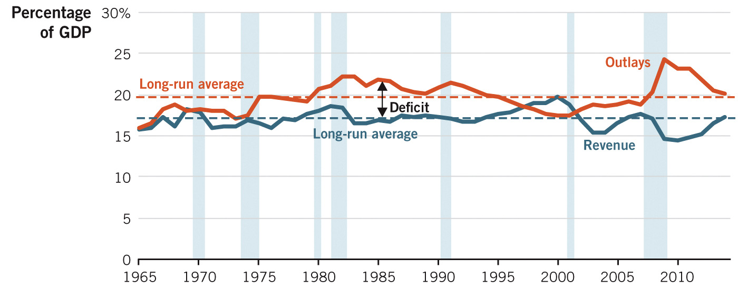
U.S. Federal Outlays and Revenue as a Portion of GDP
Notes:
Image: Figure 15.10
Lecture notes:
Regarding the figure on the slide:
The deficit-to-GDP ratio is a more informative gauge of the magnitude of deficits over time, as it accounts for economic growth.
Outlays (orange) and revenue (blue) are illustrated relative to GDP.
The deficit is the vertical distance between the lines.
Long-run averages are indicated by the dashed lines.
This figure shows us that recent spending has been above the long-run average and recent revenue has been below the long-run average.
The shaded areas indicate recessionary periods, and these indicate that deficits grow during recessions.
Note: deficits grow during recessions for multiple reasons.
Government spending (stimulus usually increases), which increases outlays.
Tax cuts are often implemented in order to increase consumption and investment, which decreases revenues.
In addition, without any change in government policy, incomes usually decline during economic downturns, which decreases the total dollar amount (proportional to income) of tax revenue collected.

Slide 33
Practice What You Know—4
Which of the following is FALSE regarding deficits?
  Deficits grow when outlays increase.
  Deficits tend to grow during recessions.
  Deficits grow when revenues increase.
  Recent U.S. budget deficits are large in a historical context.
Notes:
Clicker question:
Correct answer: C, Deficits grow when revenues increase.
All other things being equal, a deficit would shrink if revenues increased.

Slide 34
Outlays and Revenue—4
Three general observations:
  Deficits grow when:
    Outlays ↑
    Revenues ↓
    Outlays ↑ and revenues ↓
  Deficits tend to grow during recessionary periods
  Recent U.S. budget deficits are historically large
Notes:
Lecture notes:
If the government is experiencing a deficit, it must borrow funds to pay for it.
The government sells Treasury bonds to cover this difference.
The government uses the money collected from Treasury bonds to pay for outlays.
Those bonds must be repaid later plus interest.
This is similar to an individual taking out a loan and repaying it later with interest.

Slide 35
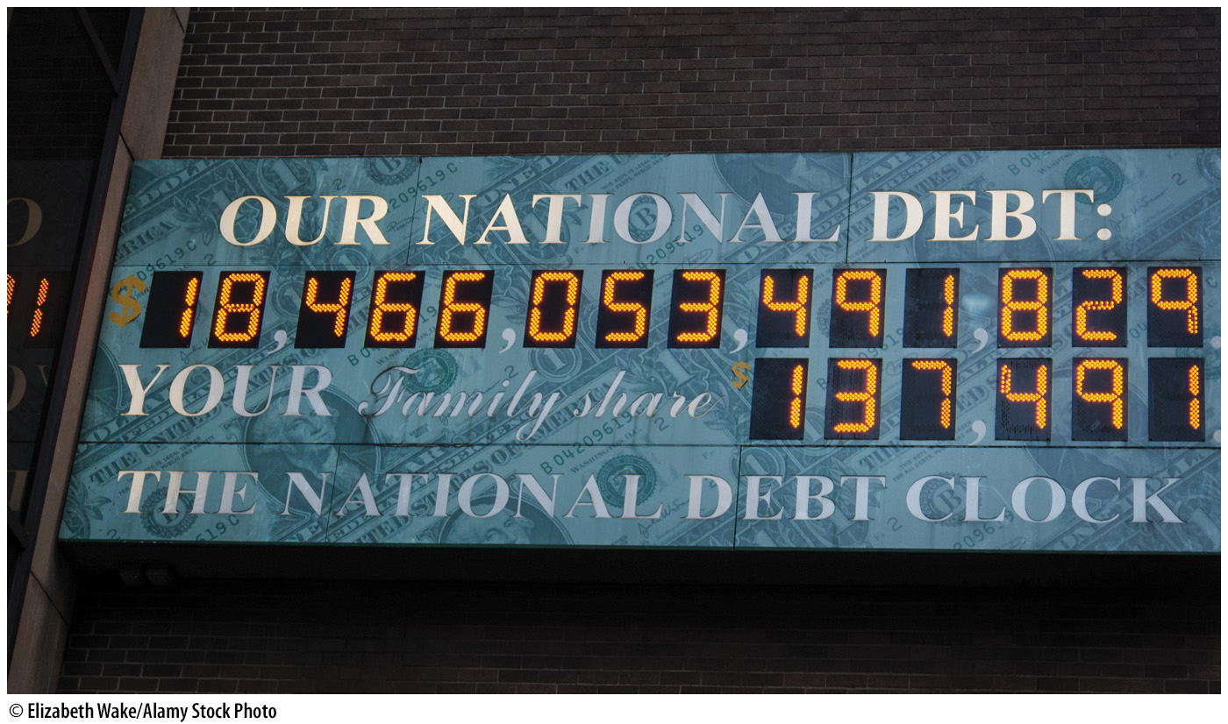
Deficits versus Debt
Deficit ≠ debt
  Deficit: outlays > revenue
  National debt: total funds borrowed by the government
The national debt
  Part is owed to the public
  Part is owed to government agencies
Notes:
Lecture notes:
If the government has a shortfall in any given year, there is a deficit in that year.
All of the yearly deficits added together equal the total national debt.
National debt is the total of all accumulated and unpaid deficits (or government liabilities).
The public can own U.S. government debt through Treasury securities.
What happens if one government agency owes another government agency money?
Sometimes a federal agency will purchase Treasury bonds.
When this happens, the government essentially owes money to itself (one branch of government can owe another branch).
It is often useful to focus on the part of the national debt that is owed to the public.
Regarding the image on the slide:
National debt totaled over $18 trillion at the time of this writing.
Your family’s share: $137,491.

Slide 36
Discuss the National Debt
www.usdebtclock.org
Notes:
“Beyond the Book” Slide
In-class activity:
Visit the debt clock web site shown.
You can spend quite a few minutes discussing each line item shown on the layout.
It’s amazing to see how fast the numbers change!
Be sure to show the class U.S. national debt, rather than U.S. total debt.

Slide 37
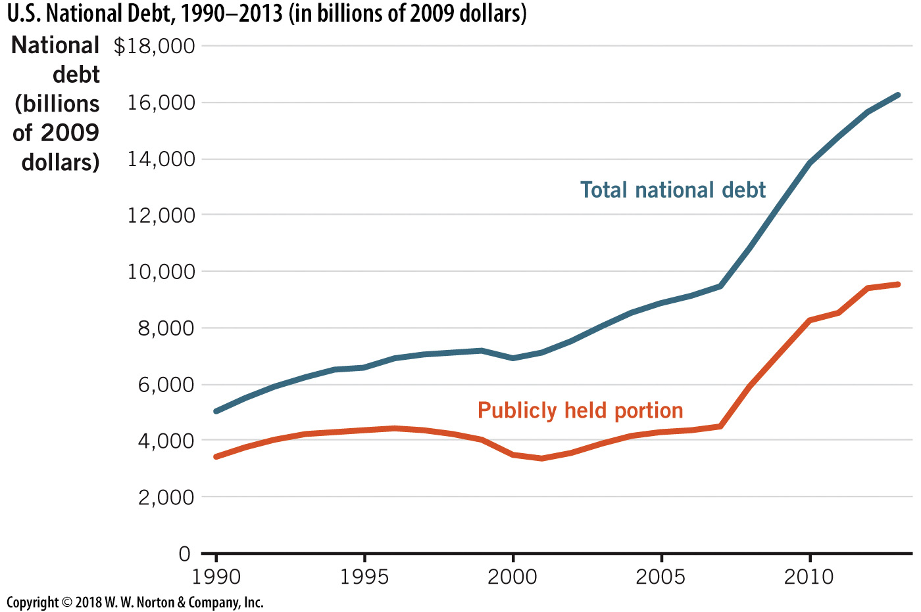
U.S. National Debt, 1990–2013
Notes:
Image: Figure 15.13
Lecture notes:
Regarding the Figure on the slide:
From 1990 to 2013, total national debt grew from about $5 trillion to over $16 trillion, often even exceeding annual GDP in the United States.
Most U.S. government debt is owned by Americans or by the U.S. government itself.
As of 2013, about 67 percent of U.S. national debt was held domestically.
This graph shows total national debt and internationally owned debt.
The percentage owned internationally has grown in recent years but is still only about 33 percent.
Still, the portion of U.S. government debt that is foreign owned more than doubled from 14 percent to 33 percent over that 24-year period.
China, Japan, and the United Kingdom are the major foreign holders of U.S. debt.

Slide 38
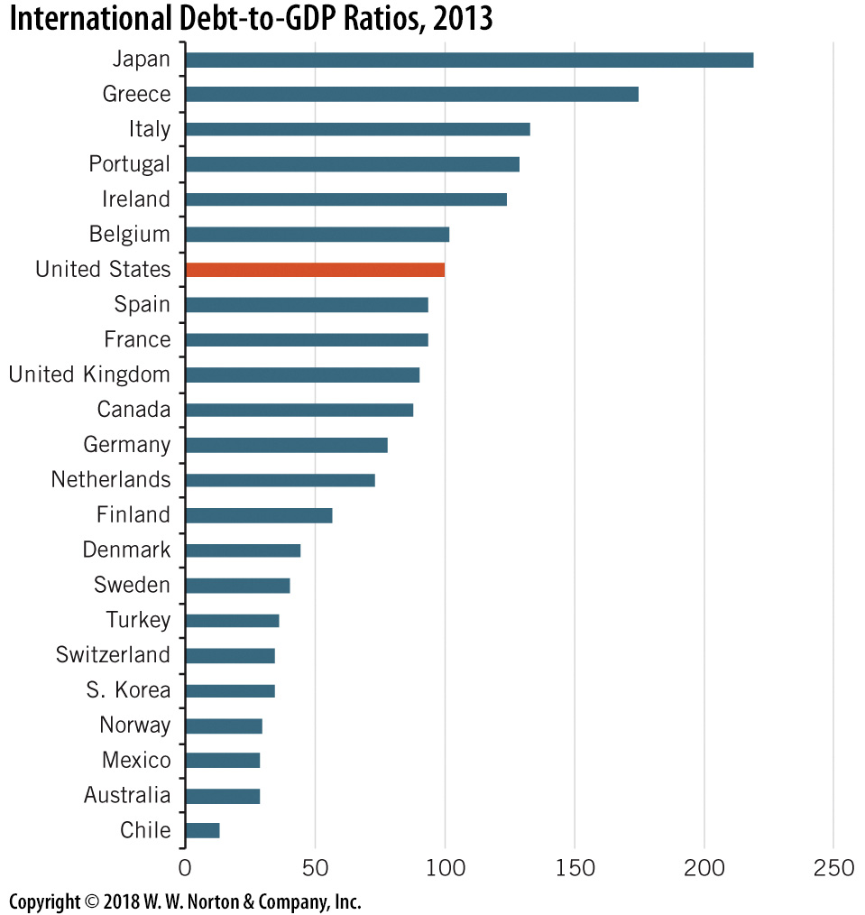
Debt-GDP Ratio, 2013
Notes:
Image: Figure 15.12
Lecture notes:
While the U.S. debt-GDP ratio has grown in recent years, it is still smaller than that of some other developed nations.
The United States has grown to 100 percent in recent years, but Japan’s ratio is over 200 percent.
U.S. GDP is about three times the GDP of Japan.

Slide 39
Practice What You Know—5
Which of the following is true?
  The United States generally has a budget surplus.
  National debt is the same as deficit.
  The national debt is the sum of yearly budget deficits.
  A deficit will occur when revenues exceed outlays.
Notes:
Clicker question:
Correct answer: C, The national debt is the sum of yearly budget deficits.
Deficits occur when outlays > revenue. The sum of deficits is the national debt.

Slide 40

Foreign Ownership of U.S. Debt
There has been public concern over international ownership of U.S. debt, but:
  67% of national debt held domestically
  33% held internationally
  Foreign lending increases the supply of loanable funds
  Decreases interest rates
Notes:
Lecture notes:
The foreign ownership of U.S. government debt is troubling for many Americans.
The concern stems from a fear that foreigners who own U.S. debt will control the country politically as well as economically.
However, according to the U.S. Treasury, as of 2013, about 67 percent of U.S. national debt was held domestically, and just 33 percent internationally.
China, Japan, and the United Kingdom are the major foreign holders of U.S. debt.
Also, it is important to realize the importance of the foreign funds to the U.S. loanable funds market.
Foreign lending increases the supply of loanable funds in the United States and then keeps interest rates low.
Lower interest rates mean that firms and governments of the United States can borrow at a lower cost.

Slide 41
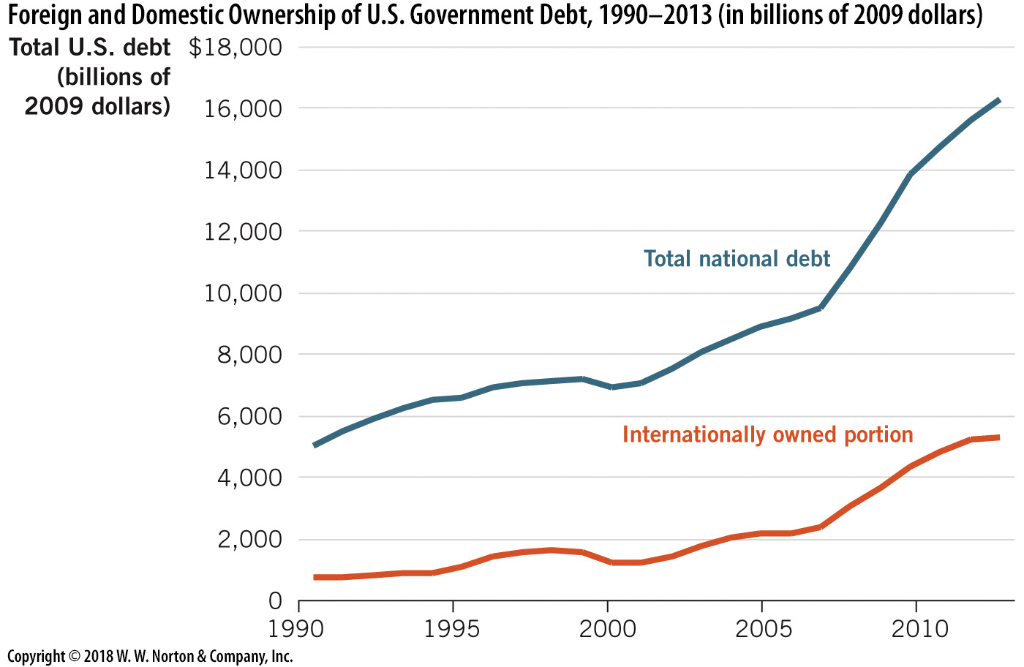
Foreign and Domestic Ownership of U.S. Debt
Notes:
Image: Figure 15.13
Lecture notes:
Most U.S. government debt is owned by Americans or the U.S. government itself.
The graph on the slide shows total debt (blue line) and internationally owned debt (dark orange line), both measured on the left-hand vertical axis.
The fraction owned internationally (light orange line) has grown in recent years, but is around one-third.
While the total national debt grew from about $5 trillion to over $16 trillion, most of the new debt was purchased by domestic investors and U.S. government agencies.
Still, the portion of U.S. government debt that is foreign-owned has doubled from about 14 percent to near 33 percent over this 24-year time period.

Slide 42
Conclusion
Government outlays = government spending + transfer payments
Government revenues: taxes
The U.S. income tax system is progressive
Debt is the cumulative sum of all annual deficits
Largest portion of outlays:
  Social Security
  Medicare
  increased due to demographic changes

